Slide 1
TEST REVISION
Reshmi Ravi

Slide 2
Overview
Thursday 23 April – 6:00 PM – 7:30 PM
Conference Centre Lecture Theatre/423-342: Aaa-Fit
Eng3407/403-407: Fre-Koo
MLT2/303-102: Kot-Pas
PLT2/303-G02: Pau-Tay
SLT1/303-G01: Te -Zzz
Content Examined: Week 1 – Week 4 (Lectures 1 – 12)
Format: Short answers and some longer responses

Slide 3
Section A: Short Answers
Go through lecture slides, find the objectives, learn and comprehend HCI terms that align with the learning objectives
Stakeholders – 4 types
Methods of Collecting data
Task Analysis
Storyboarding
Use cases
Usability? Factors, aspects and how it is measured, testing
Usability Evaluations – Fitts’ Law, Hick Hyman Law, Heuristic Evaluations?, Nielsen’s Heuristics etc
Conceptual Design – card sort, personas, semantic networks etc
Design Principles – Gulf of execution and efficiency, principles of interaction design
Visual Aesthetics
Notes:
Primary – uses the design directly, secondary – supplies input or receive output, facilitator – maintains or develops the design and indirect – affected by the use of the design but has no contact with it like coworkers
Collecting data – observation – watch people do activities; elicitation – interviews, focus groups, questionnaires. Think about the advantages and disadvantages of these methods. For example, closed ended questions in a questionnaire where you say yes or no will restrict responses but when you have open ended questions it will be harder to quantify.
Task analysis – document how people perform tasks – go through the workflow to explore the requirements of the proposed system
Storyboarding – series of pictures that describe a particular process or workflow – can study the existing workflow with or use it to help with task decomposition or even brainstorm alternative ways to complete tasks
Use cases: describe a particular goal and explore the interaction between users and the actual system components – needs actors (not exclusive to people only) but also use cases – task
You need to know things like what a requirements document would need – functions, information needed so a function is carried out, physical stuff like where it is run on, inputs/outputs, constrants
Usability is the measure of the quality of a user’s experience when interacting with a product or system - how easy are user interface to use? Does it have the required functionality? Easy to learn? Efficient to use? Memorable? Error frequency and severity? Does the user like using it?
Fitts law - Time to target depends on target width (W) and distance to move pointer (D)
Hick Hyman - The time it takes for a person to make a decision as a result of the possible choices

Slide 4
Examples
Main elements of HCI are: people, computers, _______, activities and environment.
Key design principles for user interfaces are Comprehensibility, Learnability, ____________ and Efficiency/Usability.
The ______________ models the time taken to make a decision.
In Conceptual Design, ________ are archetypes of actual users, defined by the user’s goals and attributes.
A proportion that occurs in nature, has been applied in architecture and is widely thought to be inherently pleasing is called the _______.
________ is a technique used extensively in HCI to organize items into groups.
Notes:
Interaction
Effectiveness/Usefulness
Hick-Hyman Law
Gulf of Evaluation
Golden mean

Slide 5
HTA Analysis (8 Marks) - 2014
The various departments in the university that teach programming have decided to get together and run a programming competition. The idea is that students will get together into programming teams of 4 to enter the competition. In order to register for the competition, each team must have a name and a leader. All members of a team must be enrolled students. Their names, UPIs and email addresses must be provided when the team is registered. Your task is to produce an HTA diagram of the team registration activity.

Slide 6
HTA Analysis (8 Marks)
Goal: Top level goal of the task being analysed
Plans: the order and conditions for proceeding with the sub-tasks
Information – all the information needed to undertake the task
Objects – all the physical objects involved
Methods – the various ways of doing the sub-tasks
Notes:
Goal – register themselves into teams o
Information – team name, 4 members, leader

Slide 7
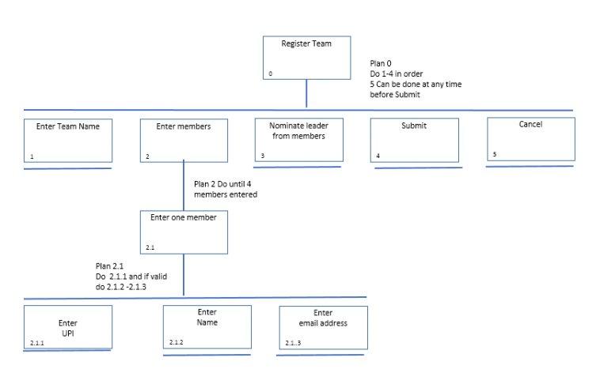

Slide 8
Heuristic Evaluation
Learn Nielsen’s 10 Usability Heuristics
Apply them to a webpage
Find possible scenarios where if these heuristics may not be applied
Visibility of system status
Search that retrieves no results
No feedback of why you couldn’t log on – password error/username error
Match between system and real world
Use of jargon?
Consistency and standards
Use of platform conventions – Location of tabs? Buttons?

Slide 9
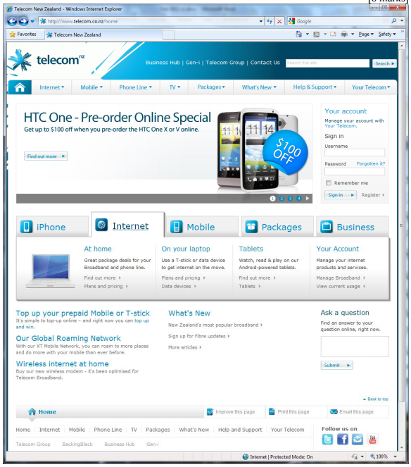
Help and documentation
Link to help and support
Aesthetic and minimalist design
Simple colour scheme
Consistency and standards
Location of tabs, consistent design – location of search bar

Slide 10
Stakeholders
Primary – uses the design directly,
Secondary – supplies input or receive output,
Facilitator – maintains or develops the design and,
Indirect – affected by the use of the design but has no contact with it like coworkers
How do you get feedback from them?
Observation
Elicitation

Slide 11
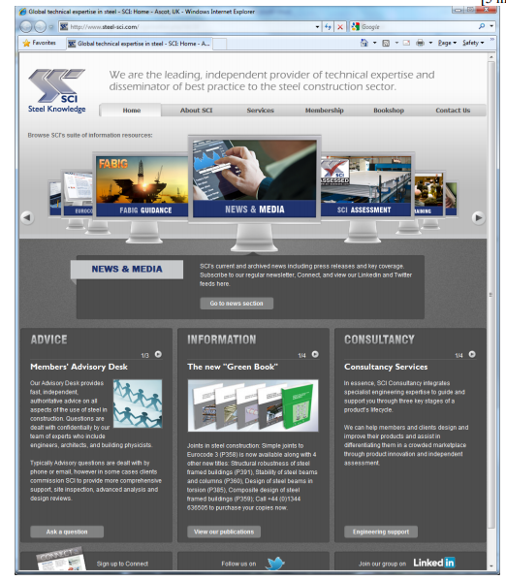
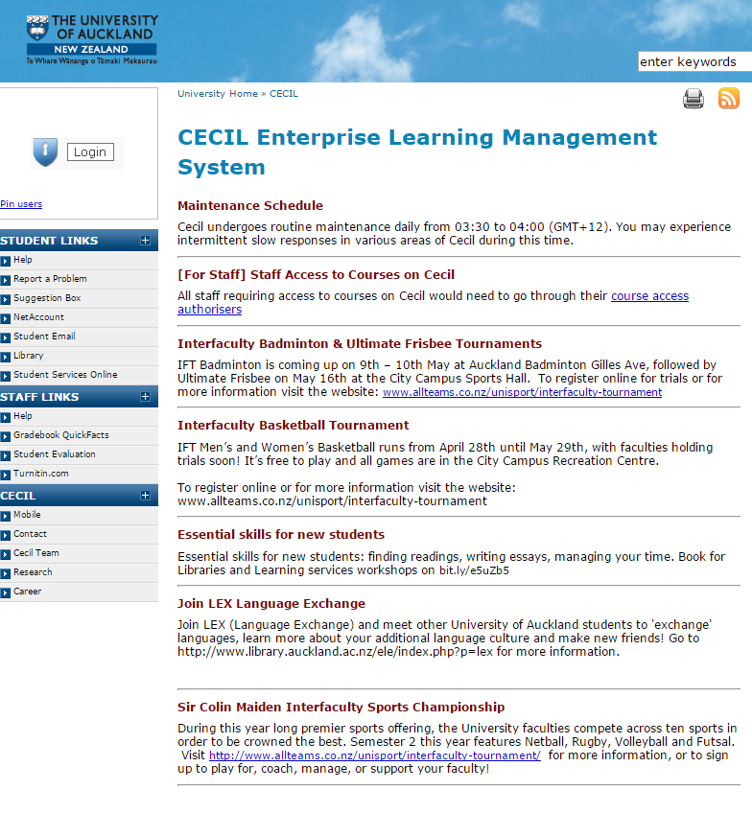

Slide 12
Steel Construction
Cecil
Primary: Steel construction sector
Secondary: Advisory desk; Consultants; Journalists
Facilitator: IT support; Design team
Indirect: SCI management
Primary: Students
Secondary: Staff, Administrators
Facilitator: IT support; Cecil team
Indirect: Heads of Departments, Senior Admin

